Slide 1
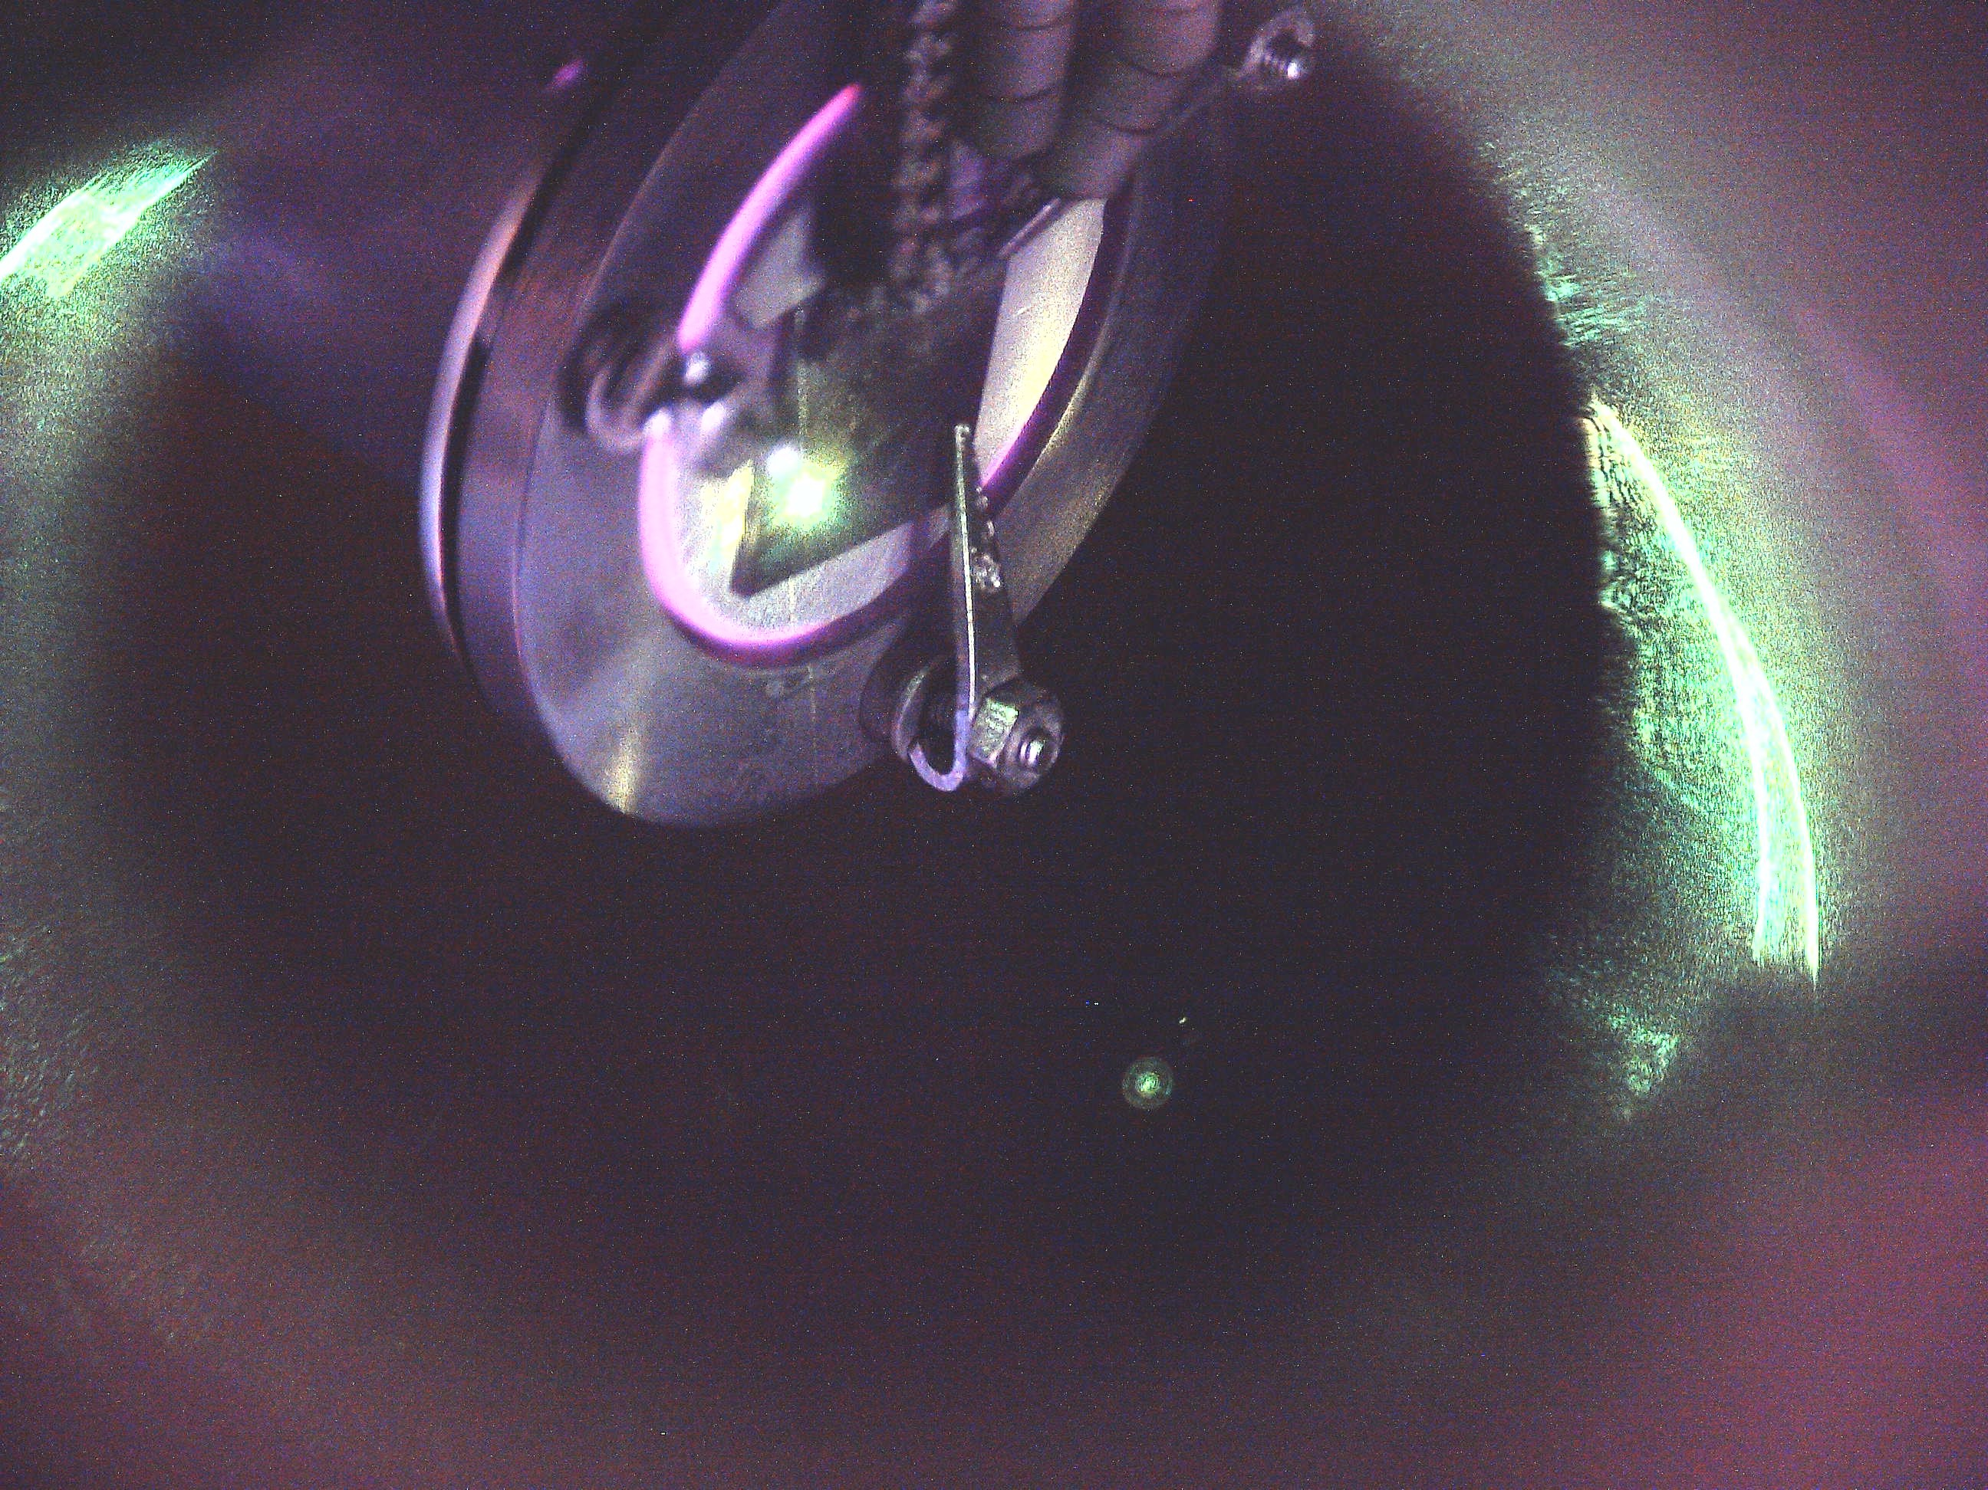
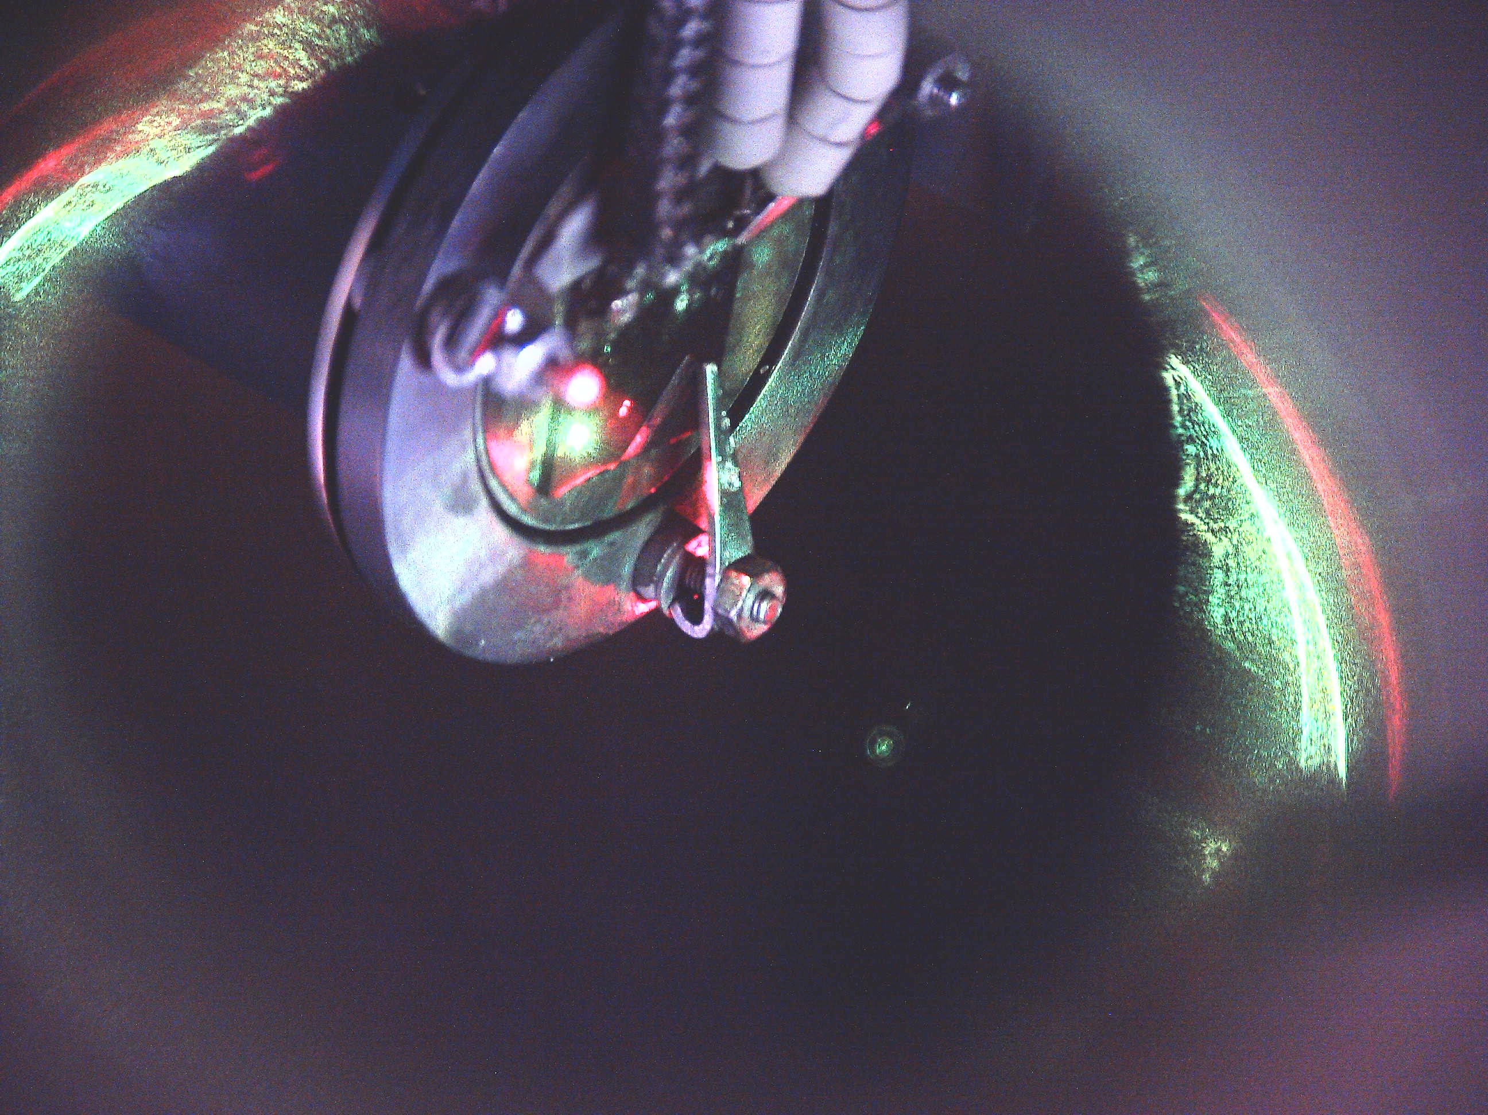
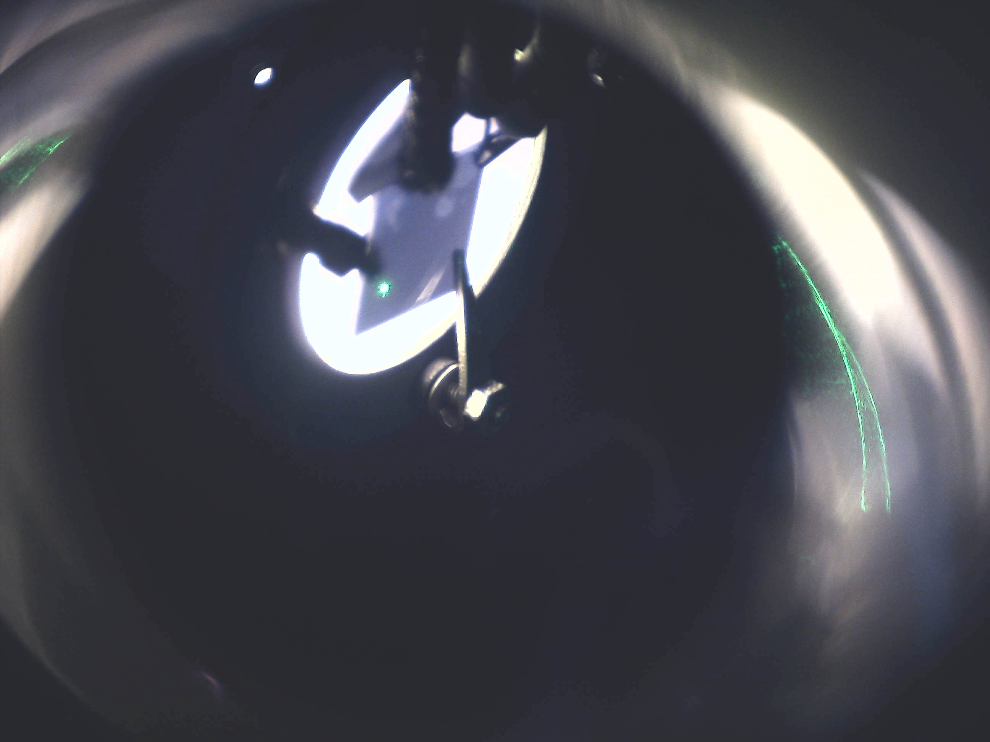
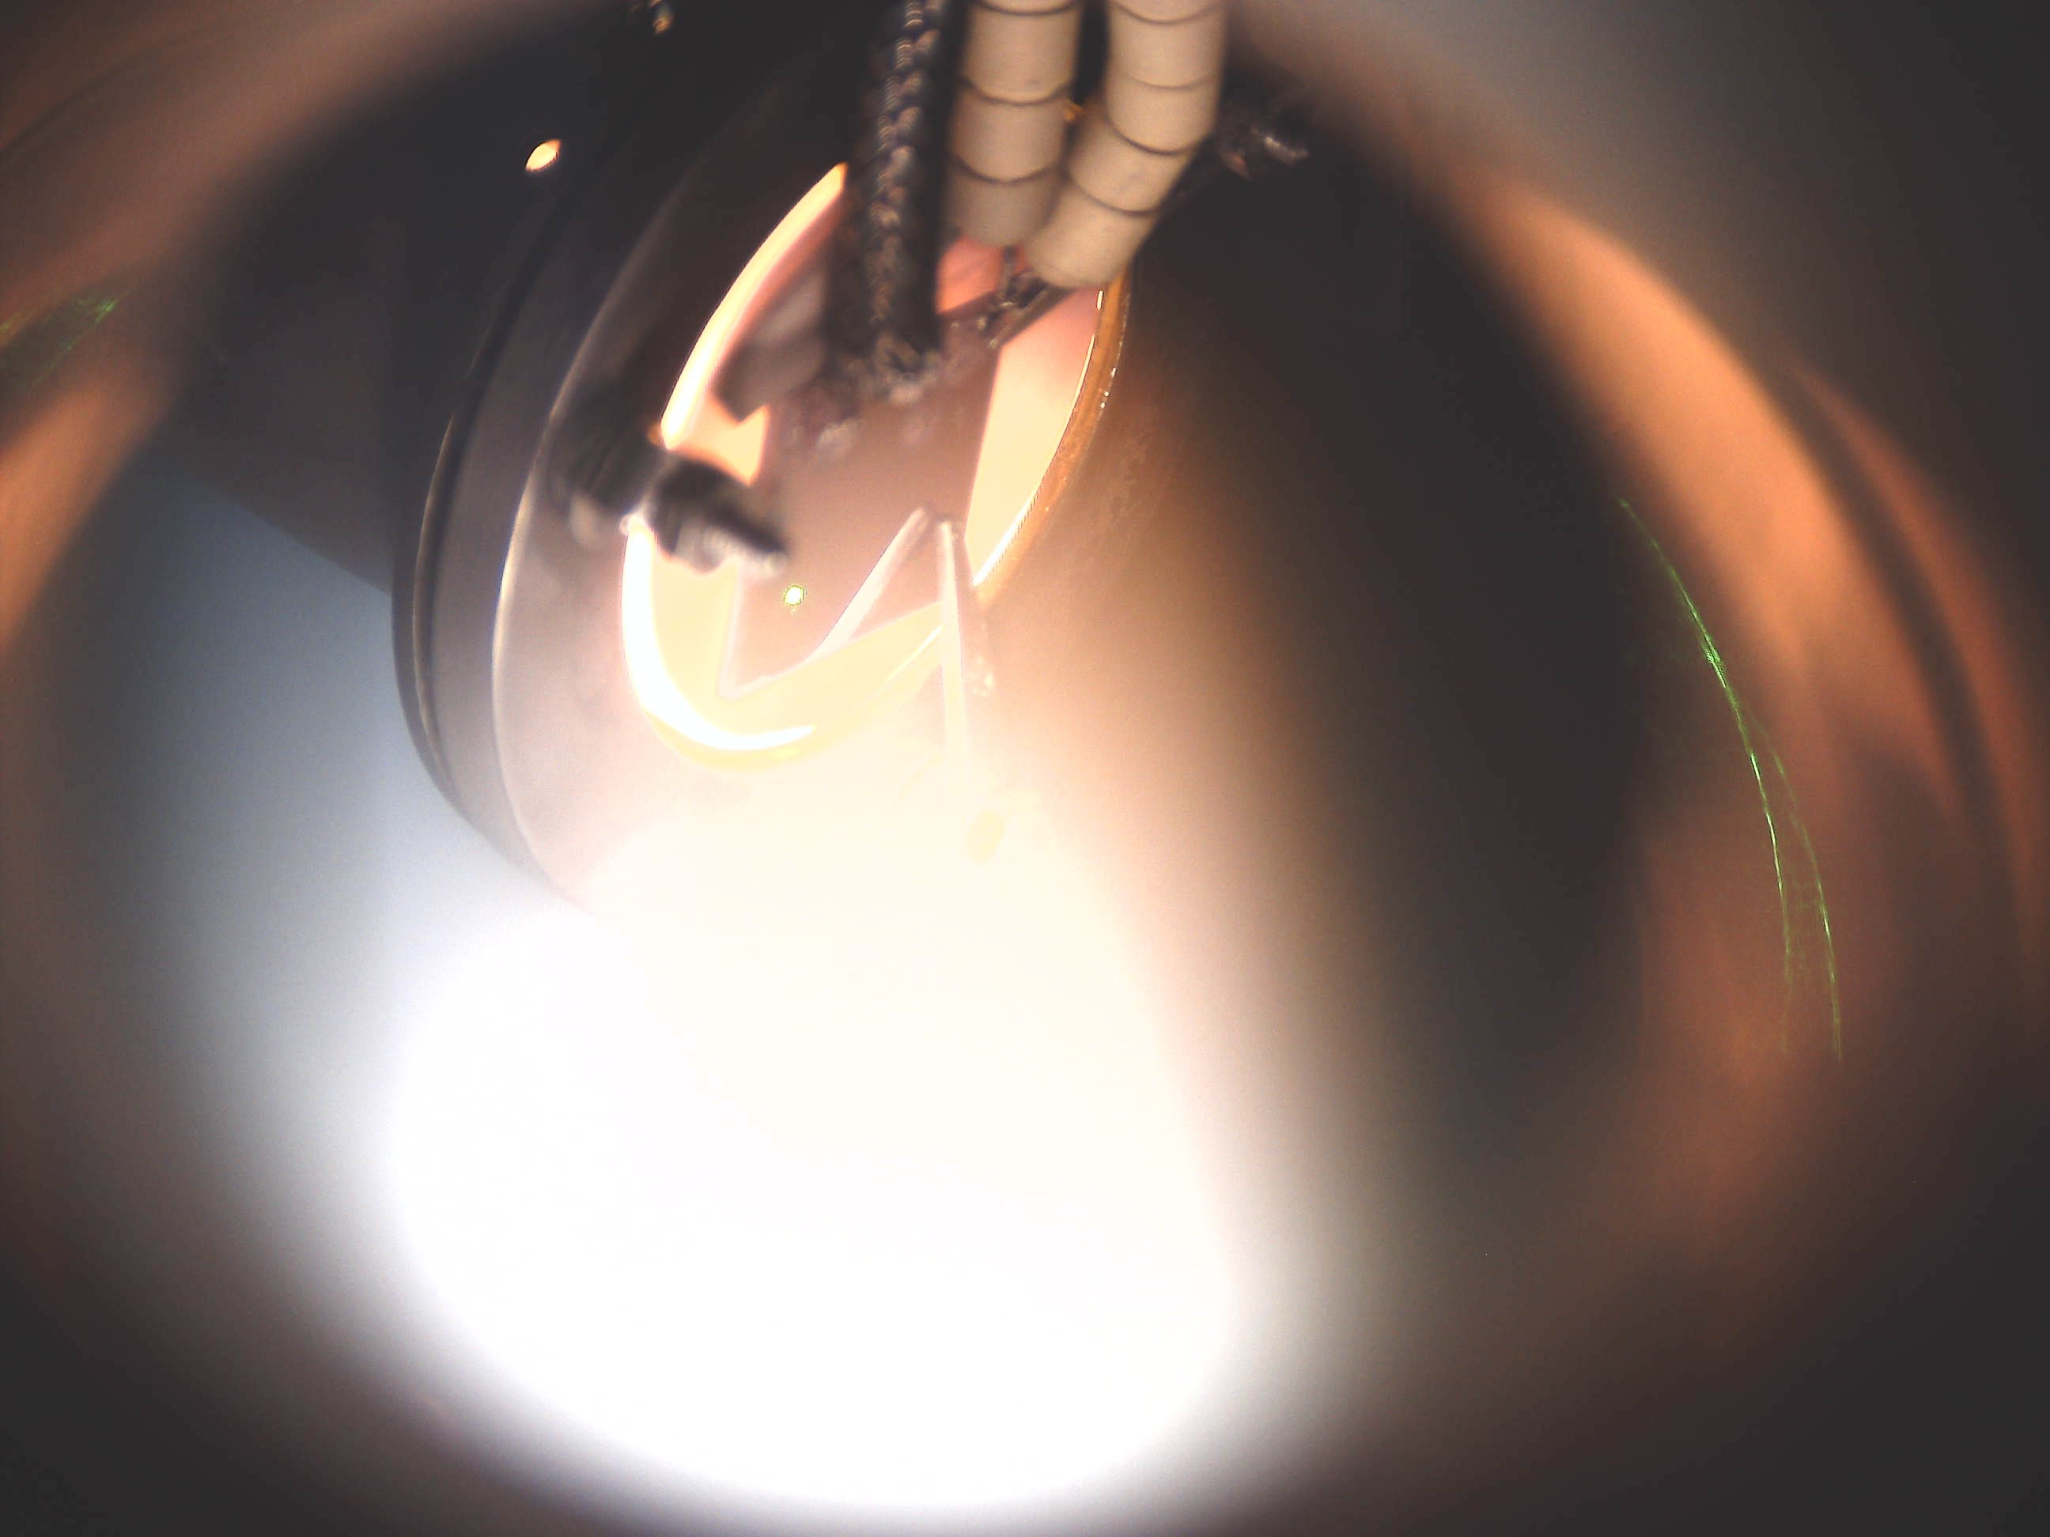
60 V sample bias
≈24 mTorr He flow
1000 W RF antenna setpoint
972 W load power
28 W reflected power
1100 ˚C maintainable on in-heater thermocouple
Variable on-surface temperature 650 – 750 ˚C
Heating start
Pyrometer spot
Plasma start
At temperature

Slide 2
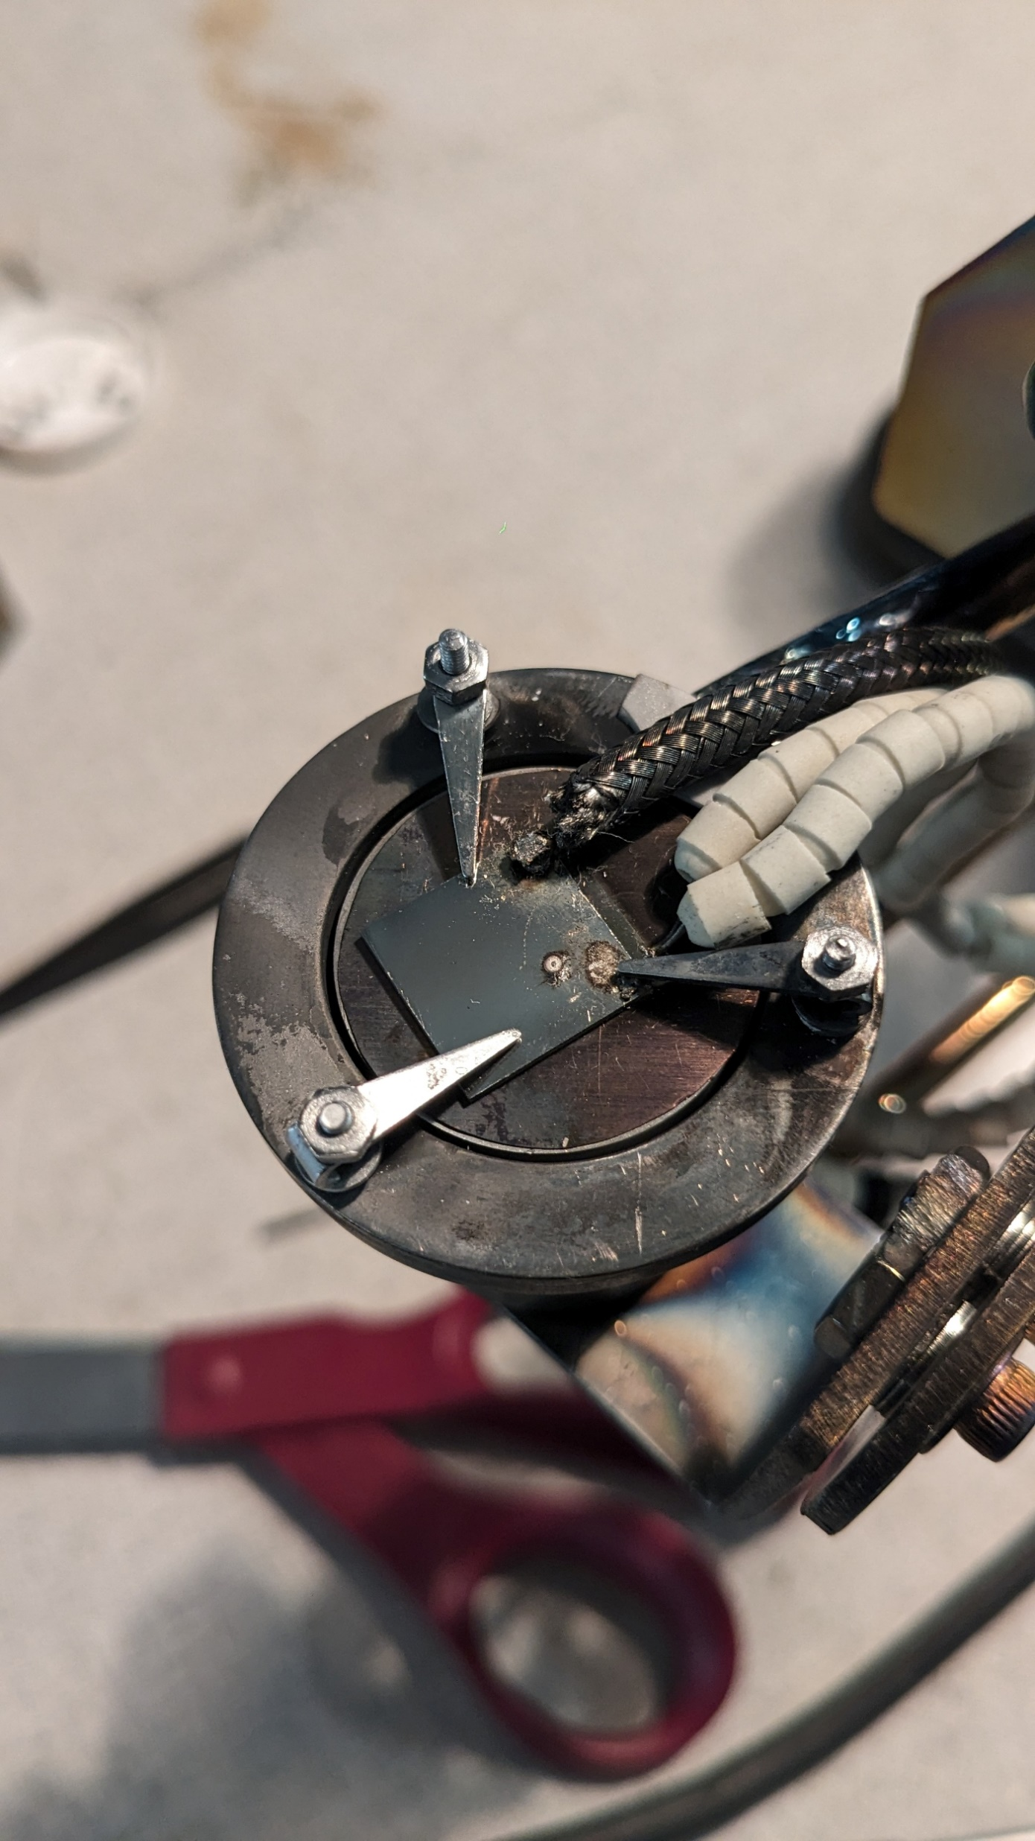
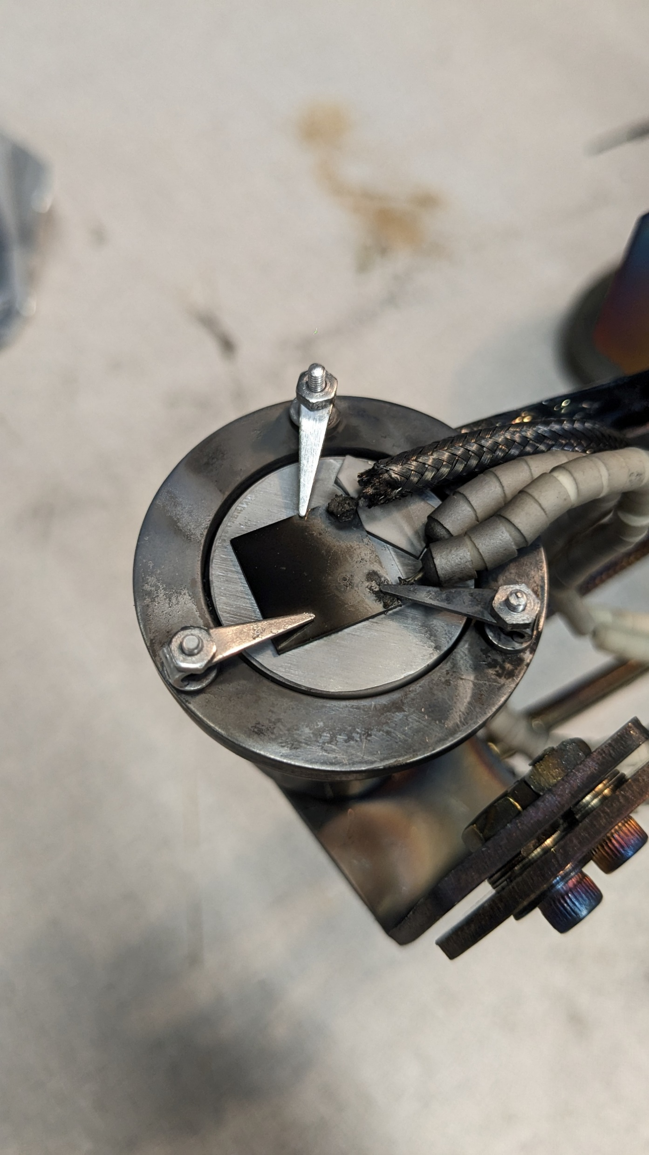
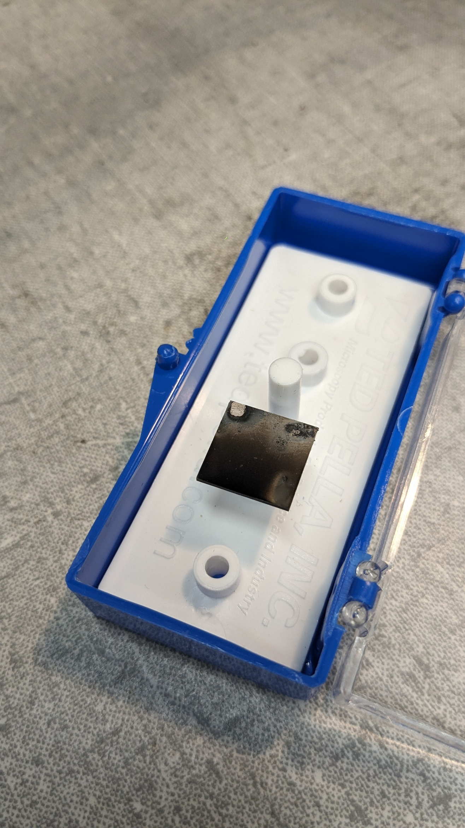
TGS spot around here

Slide 3
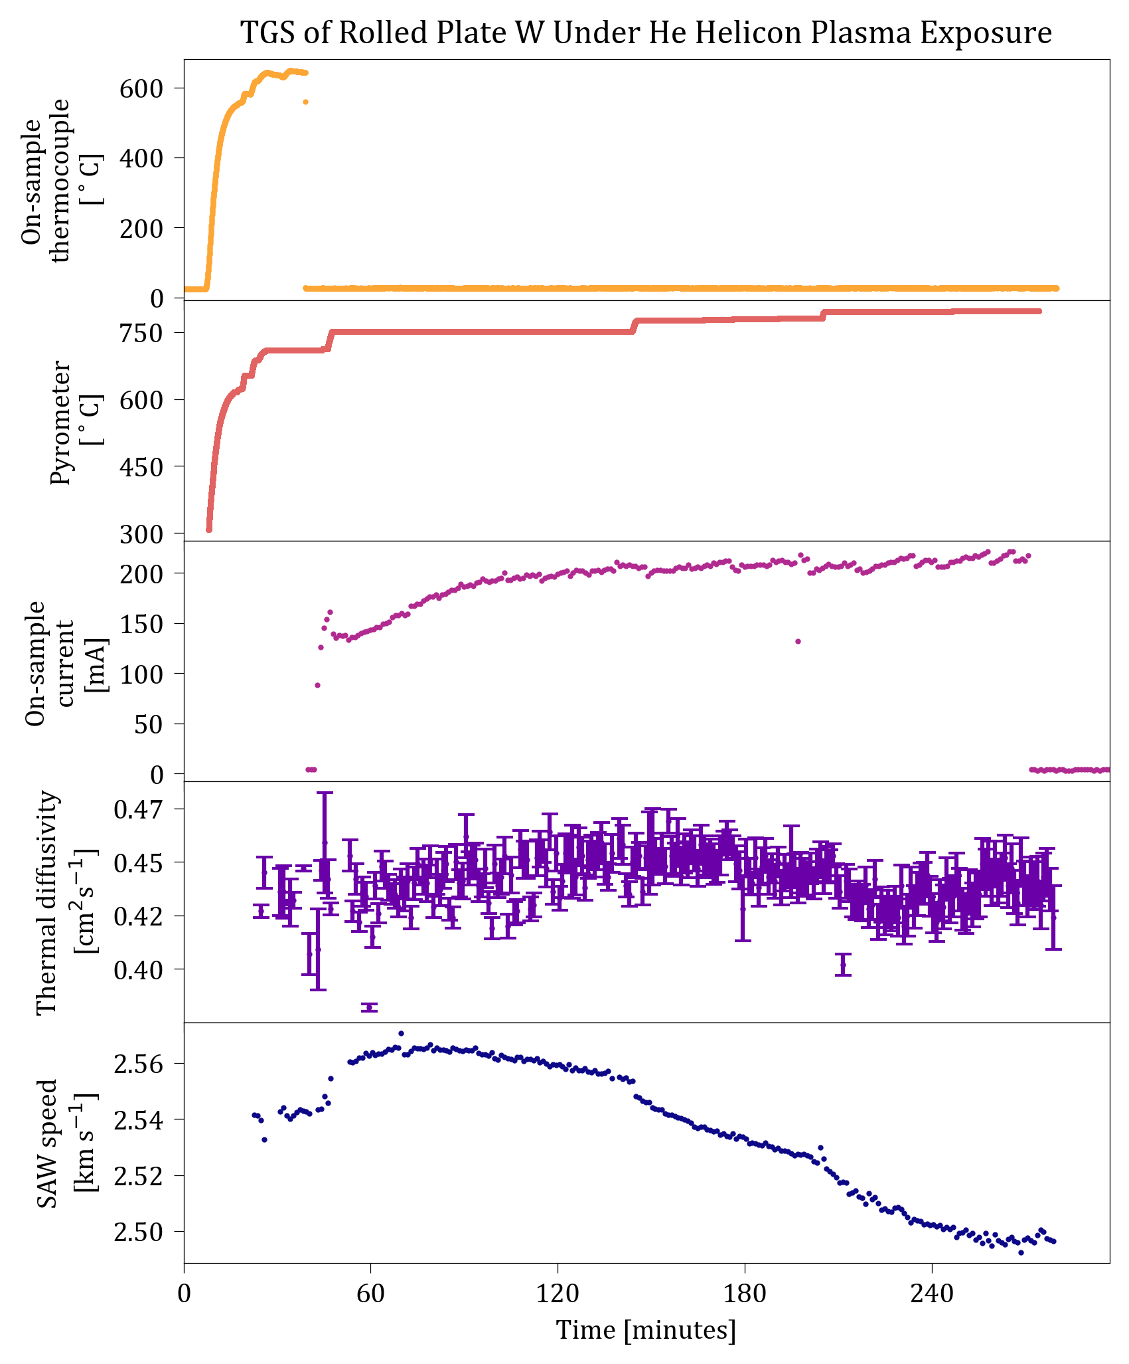
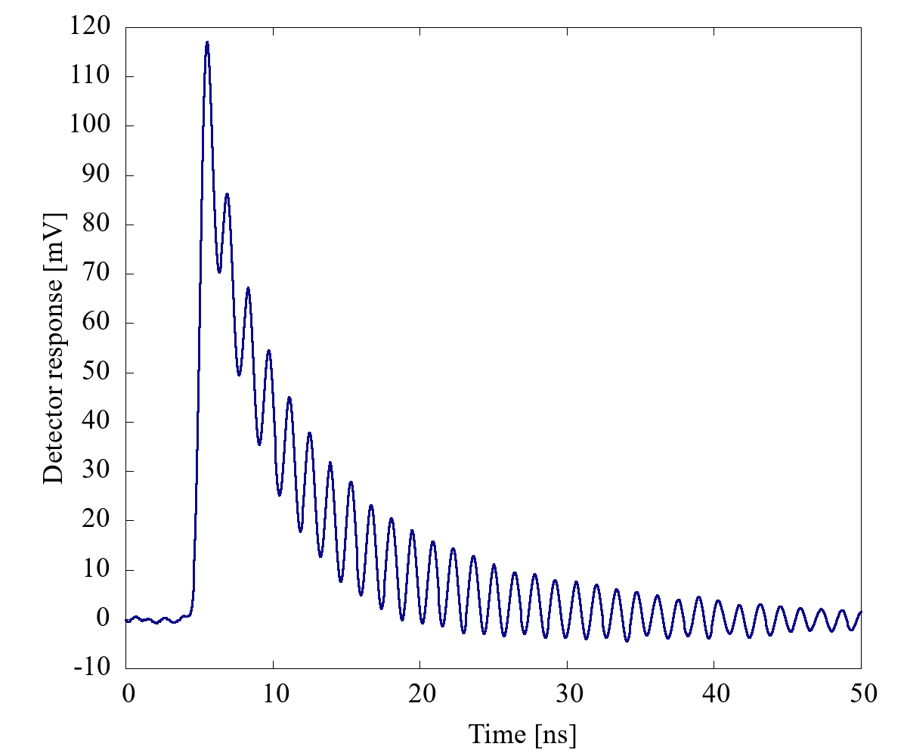
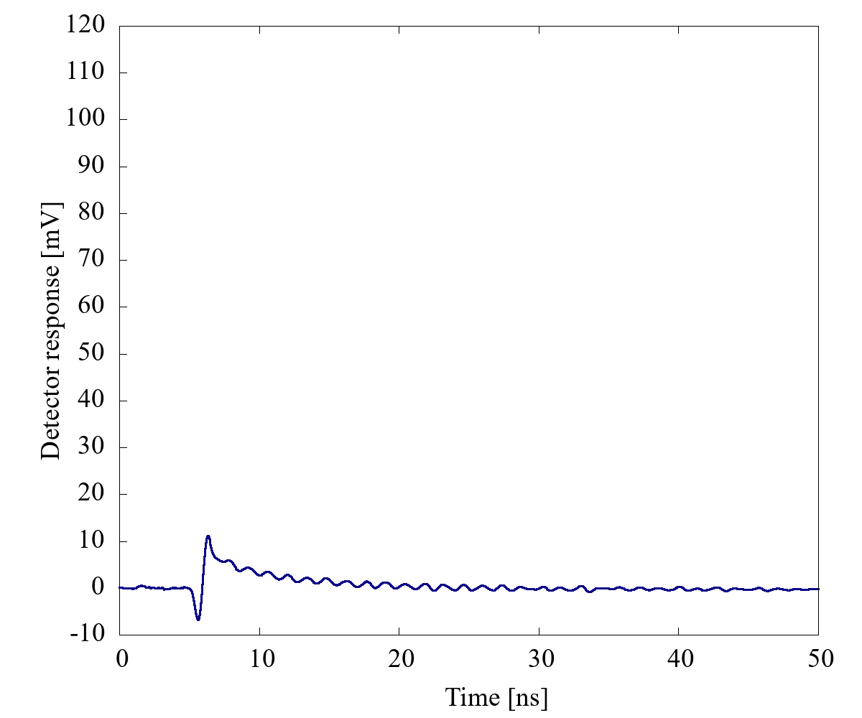
Run start
Run end

